Slide 1
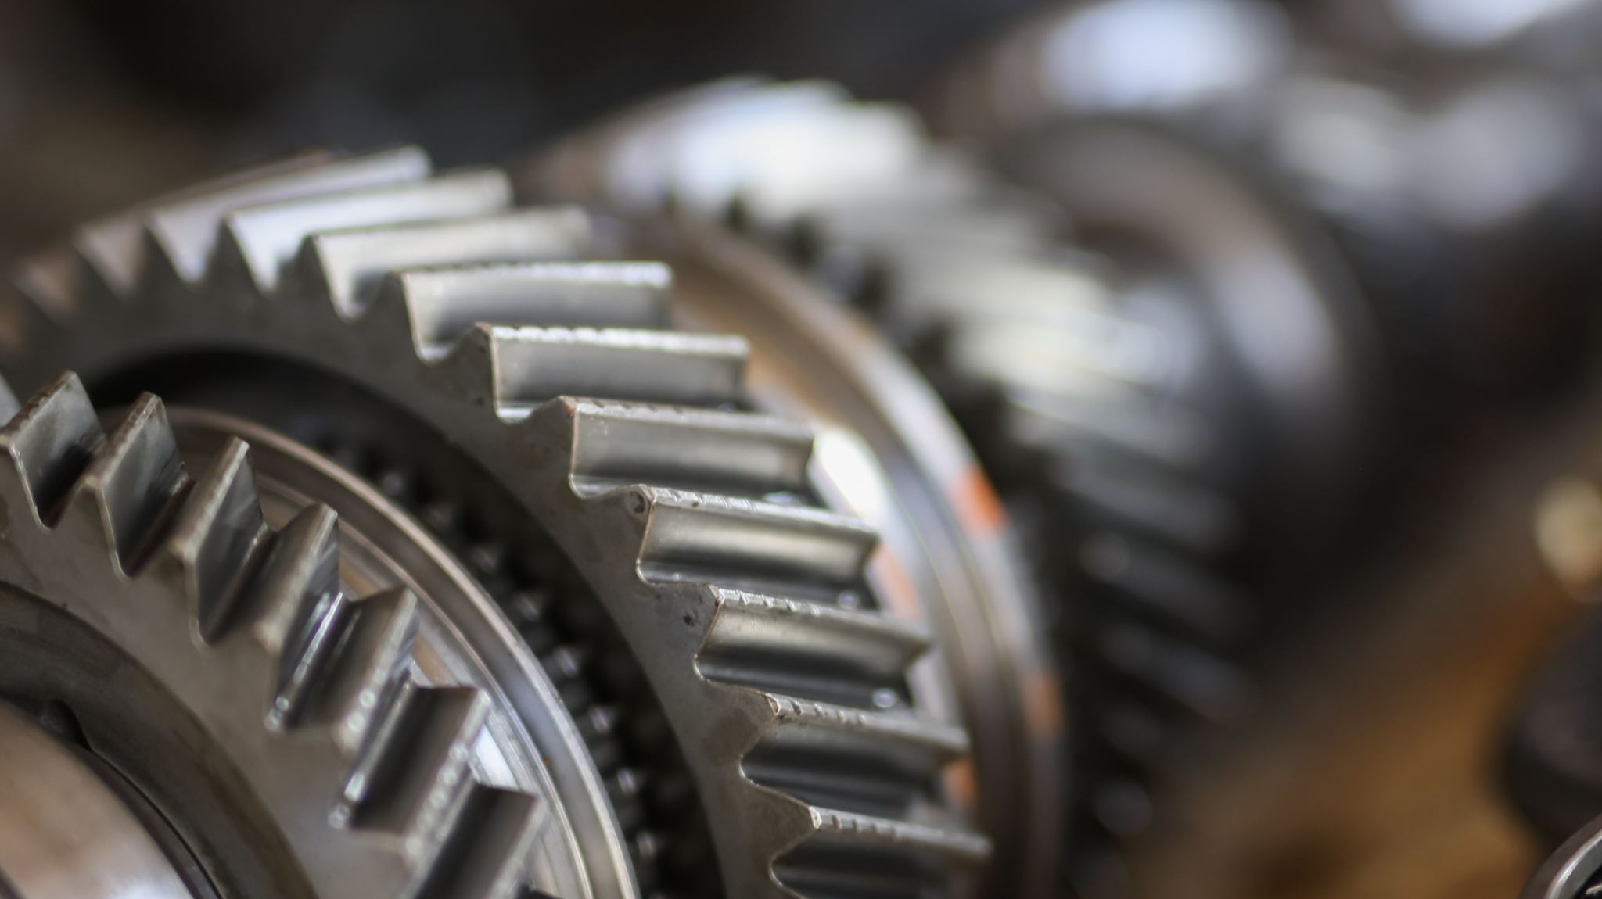

Multi-Cylinder Internal Combustion Engine
MNG241
DR. Raafat Shalaby

Slide 2
Team members:
Mohamed Aboelkhair ID: 231001405
Amro Maged Mohamed ID: 231001357
Moemen Ahmed ID: 231001011
Saif Adbelmoamen ID: 231001990
Adam Hussein Saeid ID: 231000724
Osama Walid Mohamed ID: 221000999

Slide 3
Content:
Introduction
Common Aspects Modeled in ICE Simulation
Design
Mathematical modeling
Modeling and simulation
3D printing & Prototype

Slide 4
Introduction:
The project focuses on developing and analyzing a dynamic model of a motor-driven slider-crank mechanism, which is essential for converting rotational motion to linear motion in machines like engines and pumps.
It explores the interaction of electrical, mechanical, and kinematic principles to better understand the system's dynamic behavior, aiding in its design, control, and performance evaluation.

Slide 5
Common Aspects Modeled in ICE Simulation:
Thermodynamics
Combustion models
Fluid dynamics
Heat transfer
Mechanical dynamics
Fuel injection and ignition timing
Emission models

Slide 6
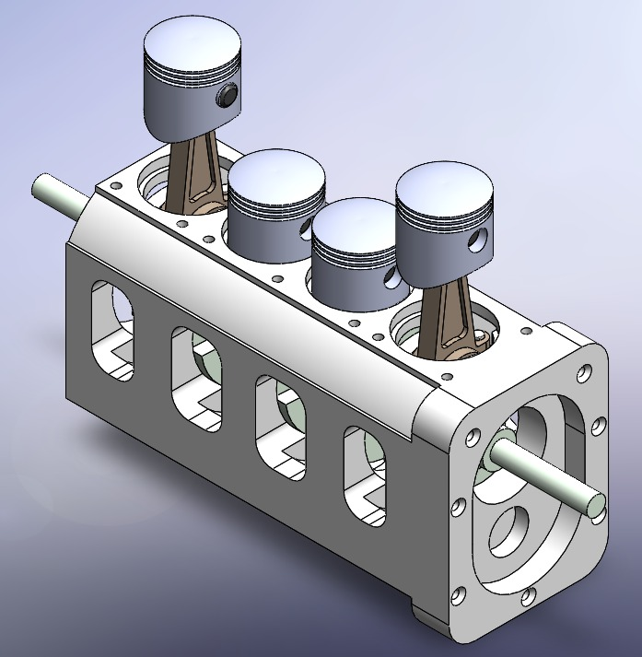
Design:

Slide 7
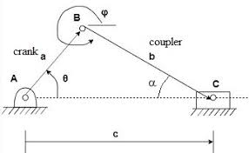

Mathematical modeling:
a=$r$, b=$l$, c=$r_{2}$, $θ$=$θ_{2}$, $φ$=$θ_{3}$
$r_{2}+r_{3}−r_{1}=0$
x $r\cos{θ_{2}}+l\cos{θ_{3}}−x=0$
y $r\sin{θ_{2}}+\operatorname{lsin}{θ_{3}}=0$
$\sin{θ_{3}}=\frac{−r\sin{θ_{2}}}{l}$
$$θ_{3}=\sin^{−1}{(\frac{−r}{l}\sin{θ_{2}})}$$
$x=r\cos{θ_{2}}+l\cos{θ_{3}}$

Slide 8
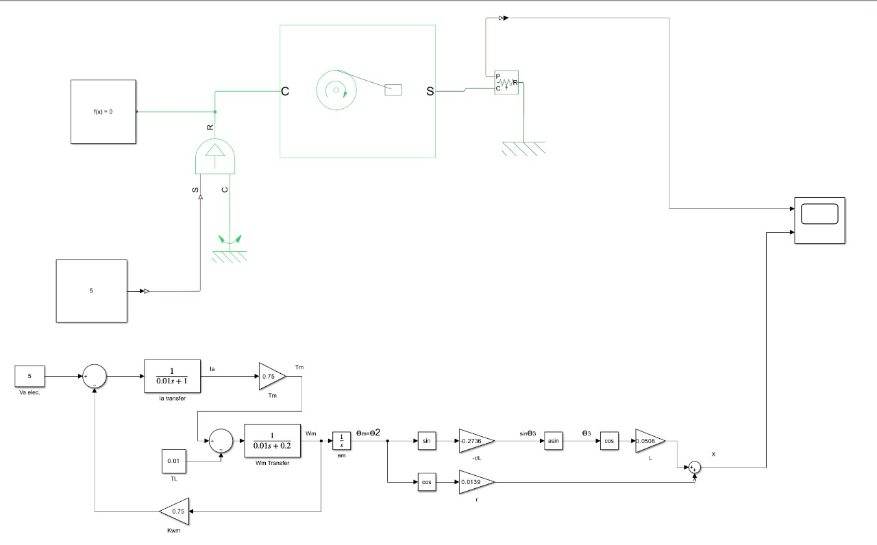
Modeling and simulation:
Simulink & simscape

Slide 9
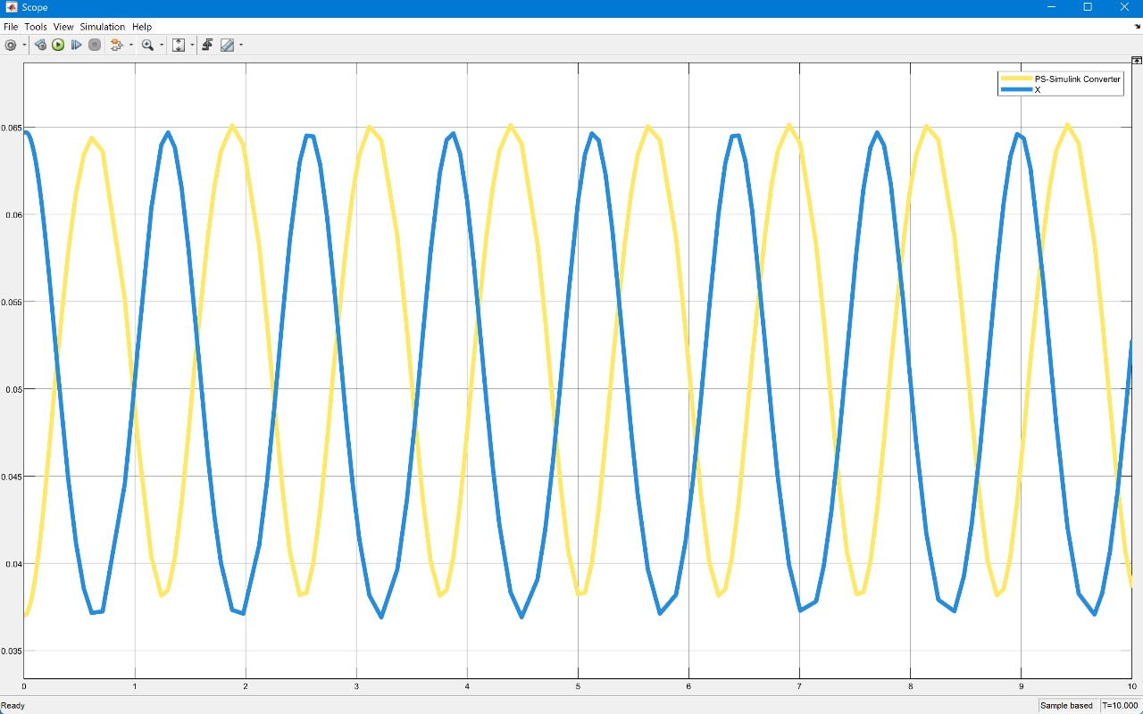
Modeling and simulation:
Scope:
Displacement and time

Slide 10
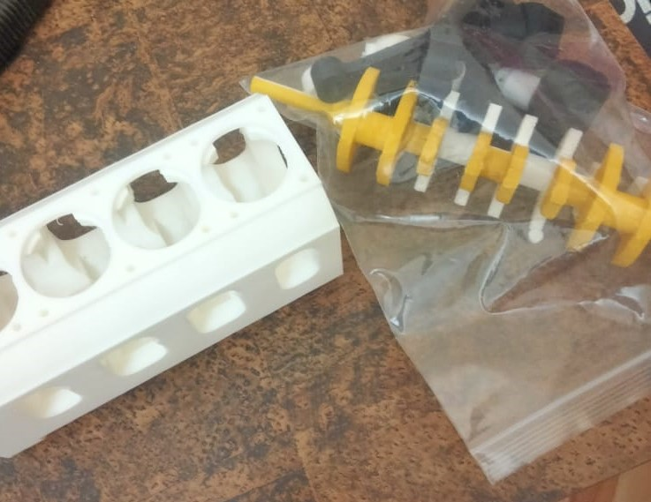
3D printing :

Slide 11
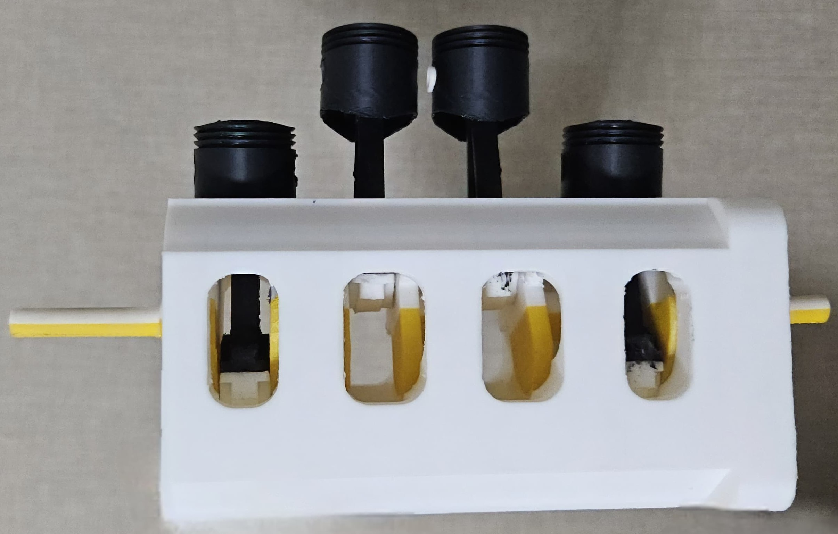
Prototype:

Slide 12

Thank you

